Slide 1
Mathematical OCR - Presentation 2
MAYANK AHUJA
SC18B037

Slide 2

Dataset used in this model - HASYv2
168236 png images, each 32 x 32.
It has 370 total classes.
Contains English Alphabets (Capital and small), digits, Greek letters and Mathematical Symbols.
Size = 143 MB.
A sample Image of pi is shown here -
Some more data visualisation is shown in coming slides

Slide 3
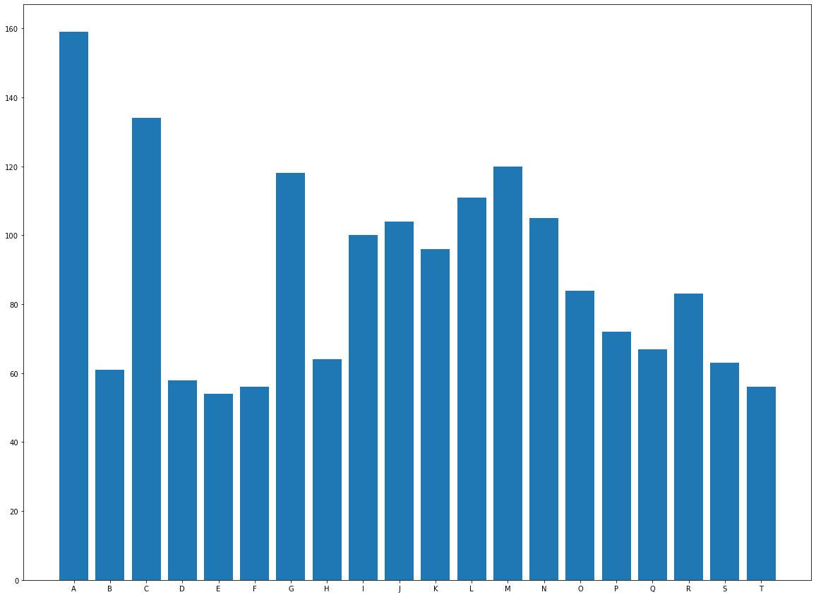

Slide 4
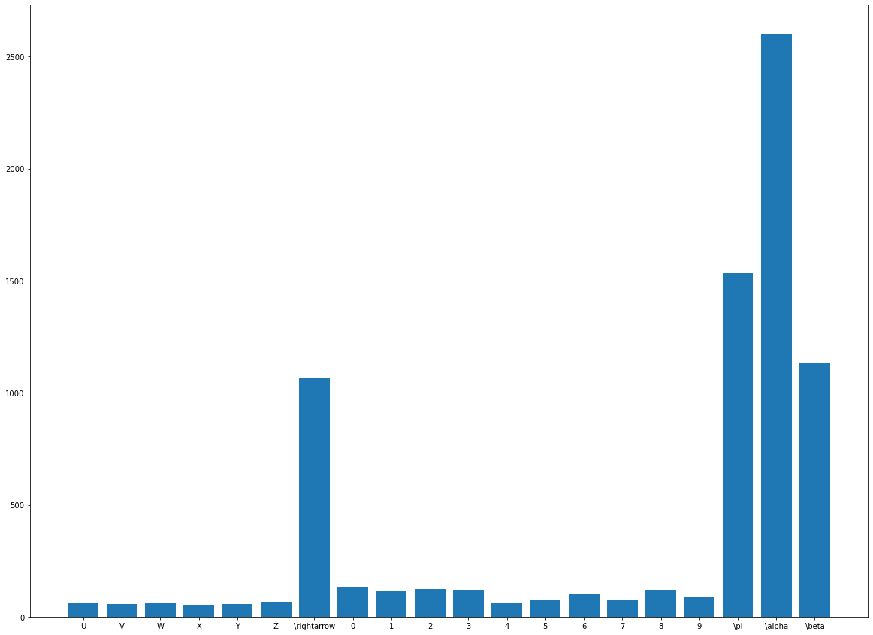

Slide 5
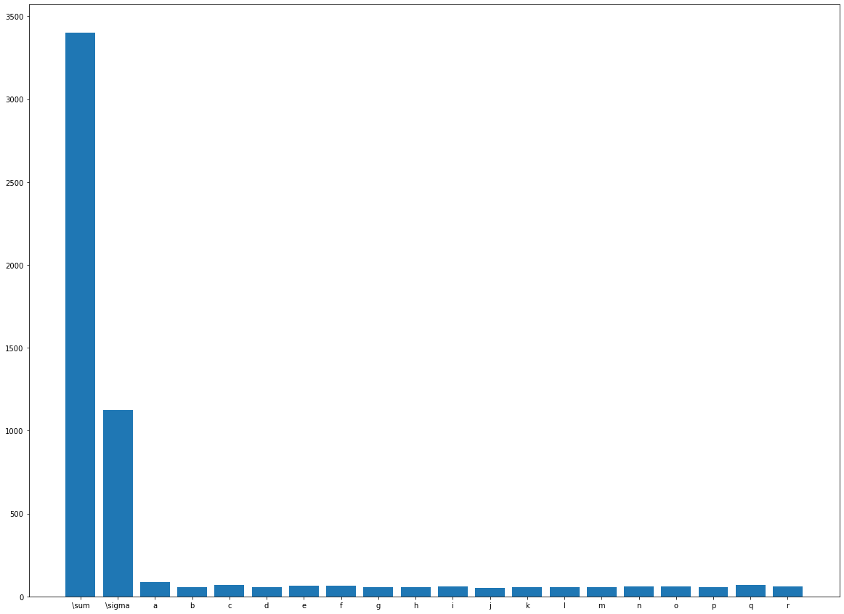

Slide 6
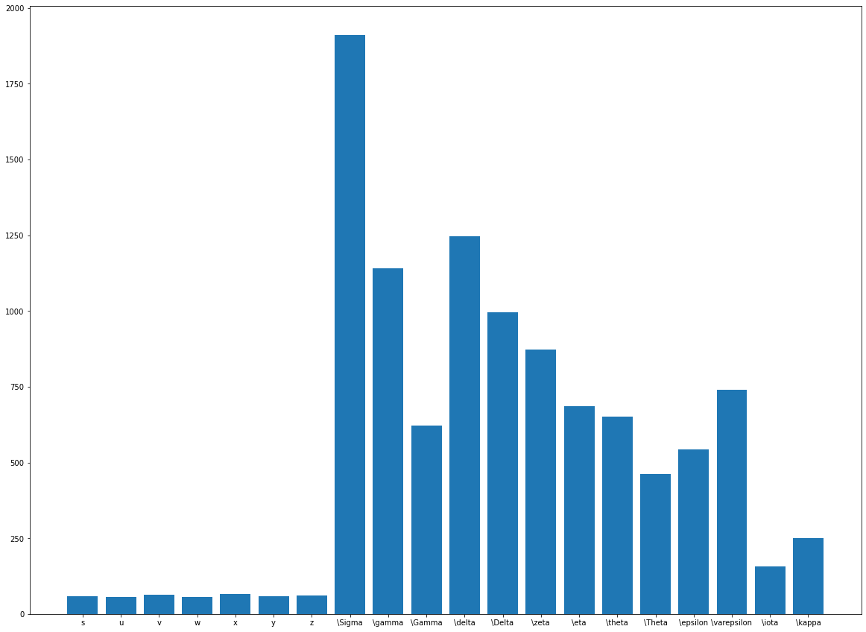

Slide 7
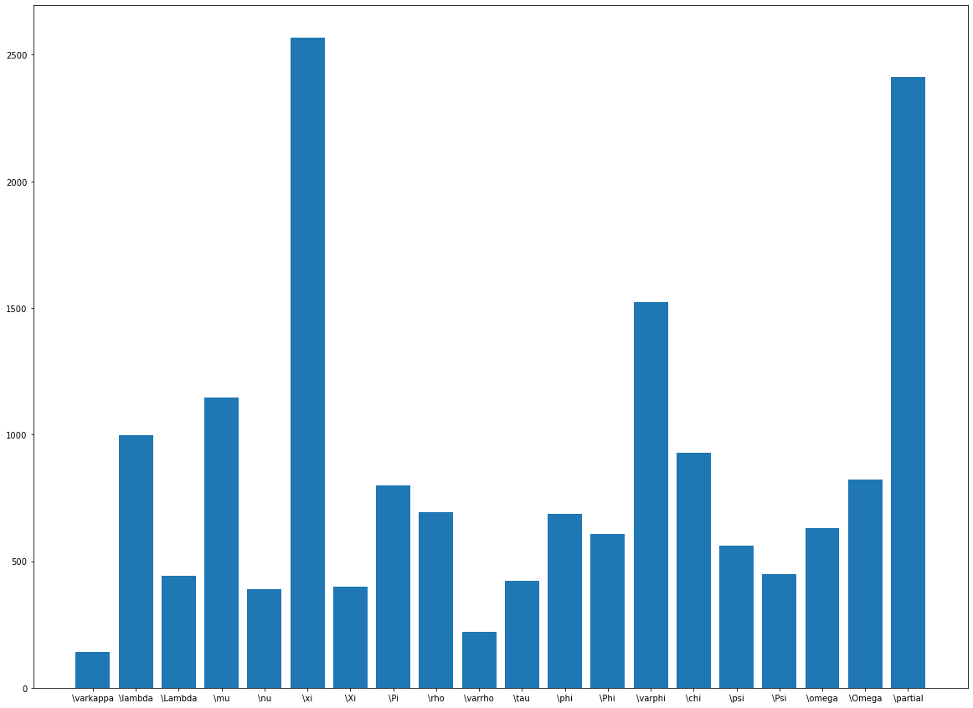

Slide 8
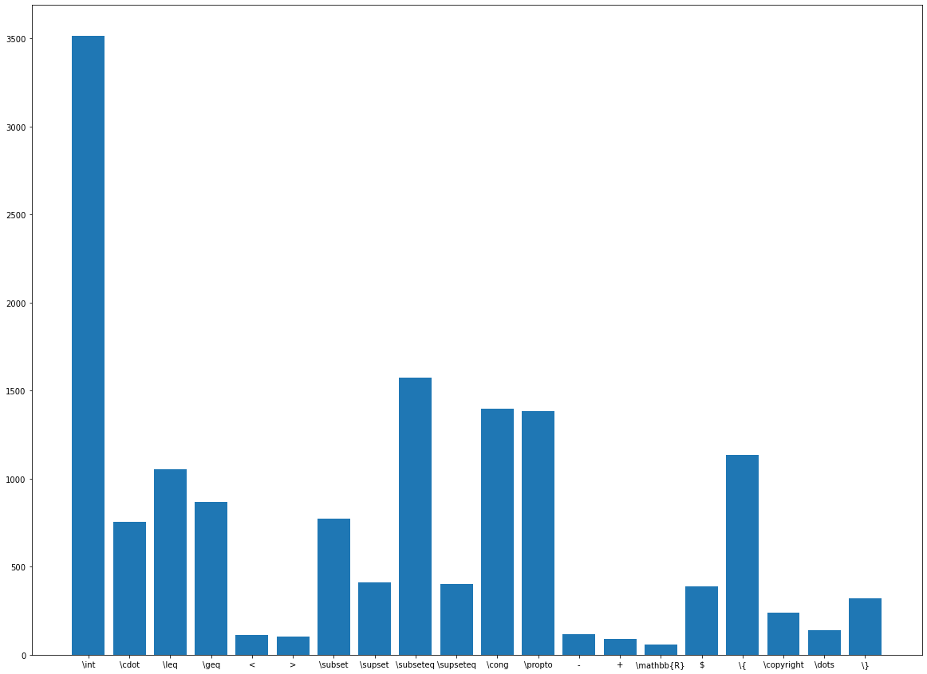

Slide 9
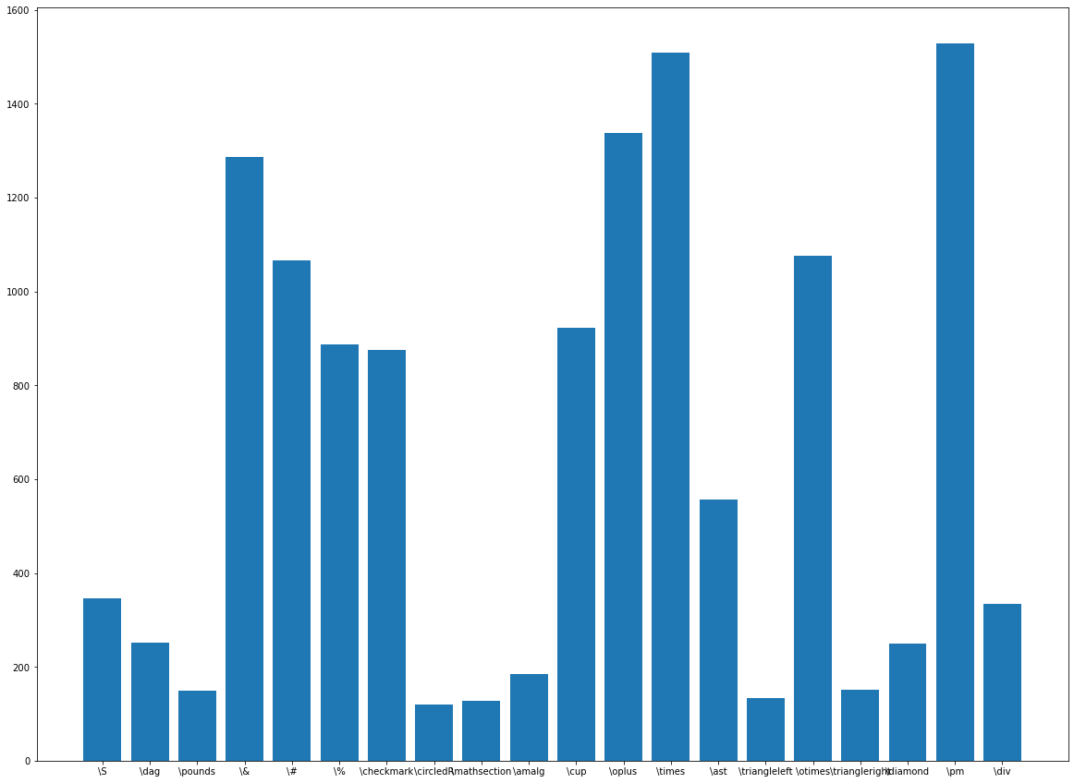

Slide 10
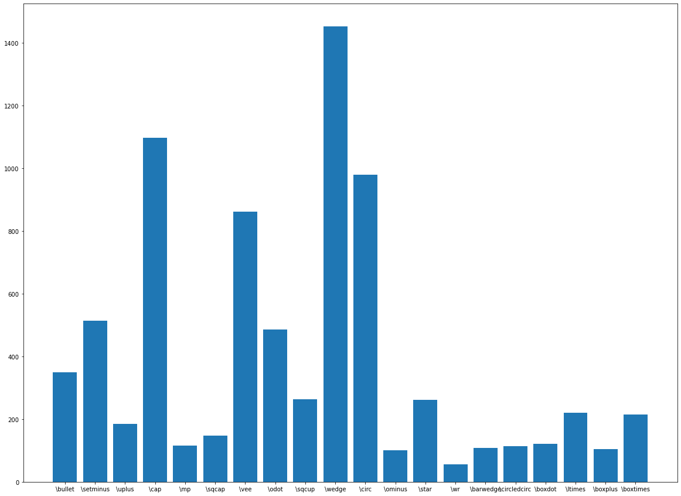

Slide 11
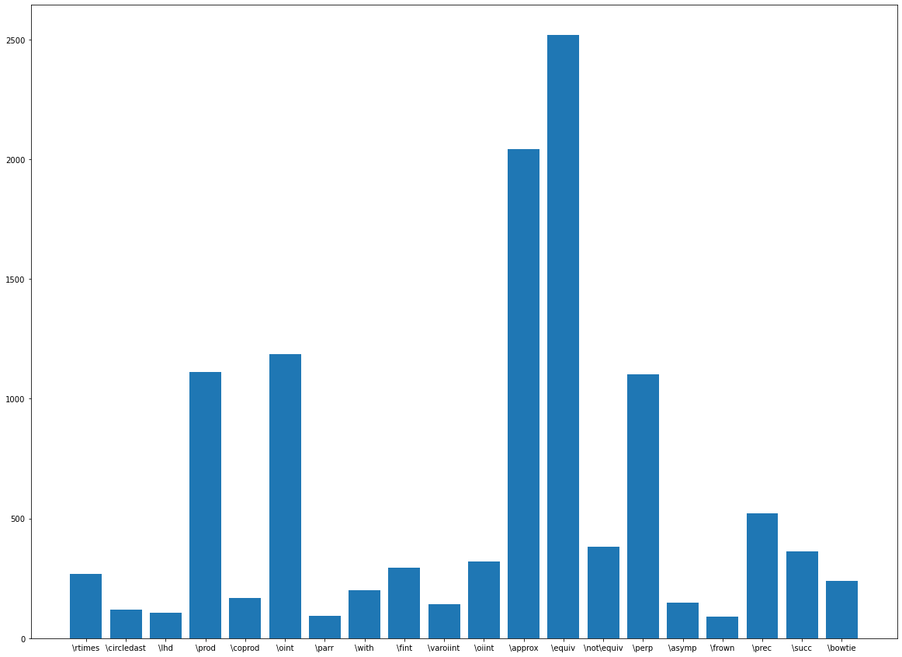

Slide 12
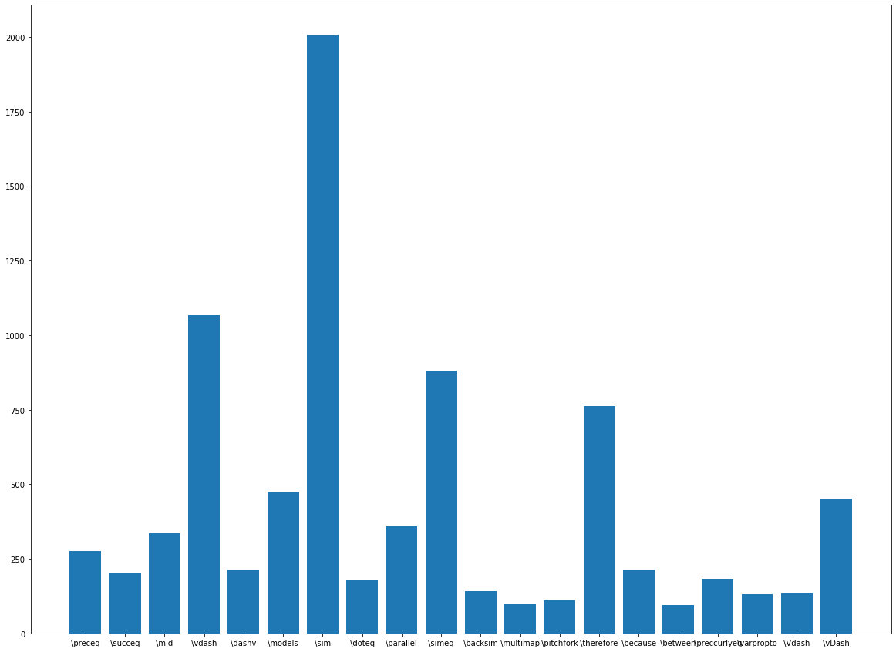

Slide 13
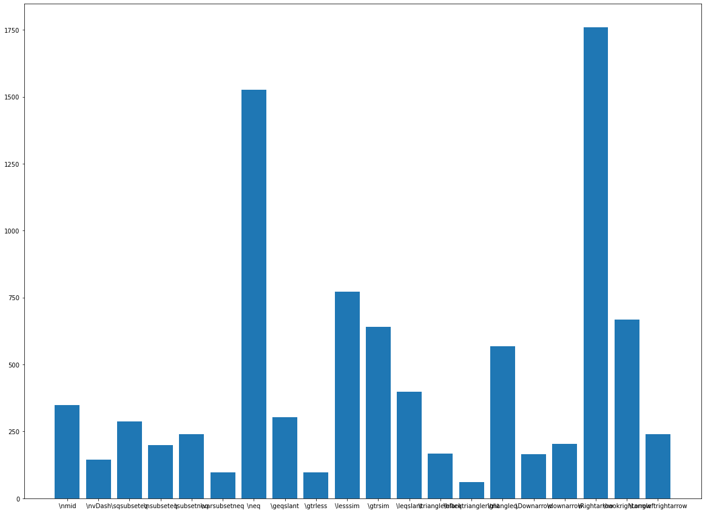

Slide 14
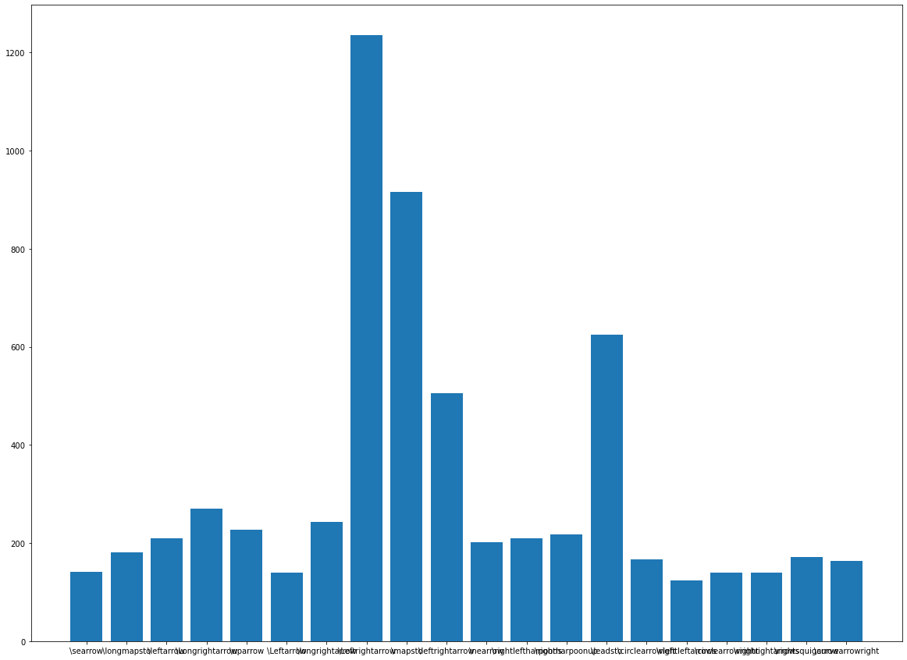

Slide 15
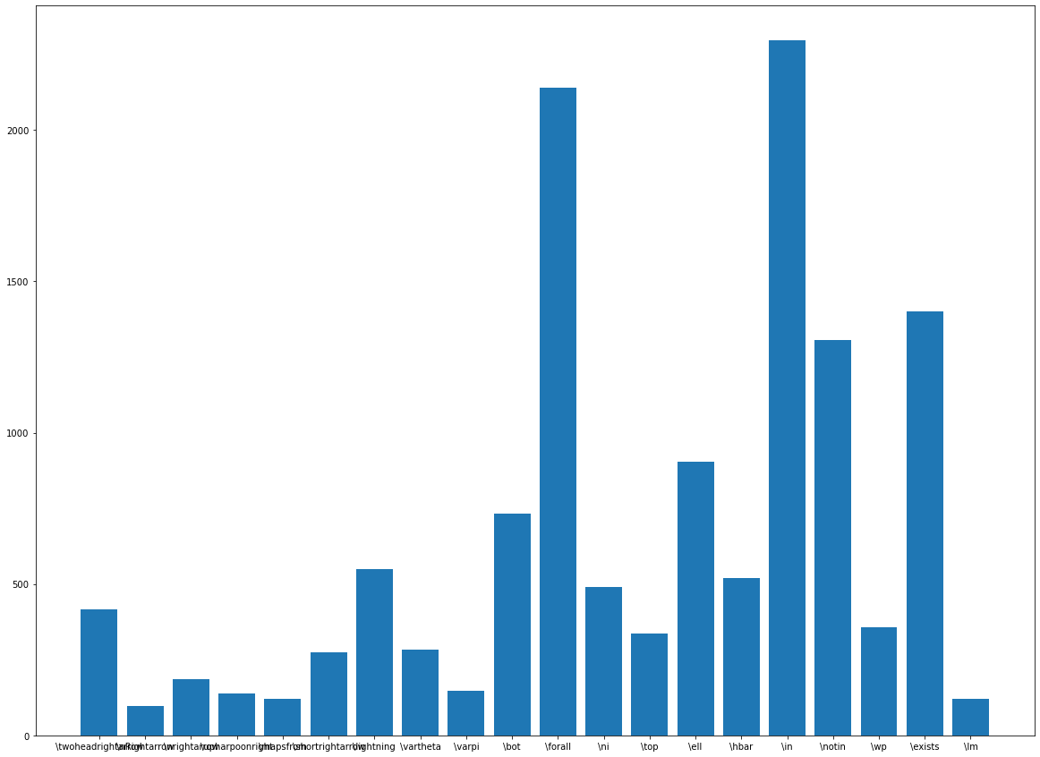

Slide 16
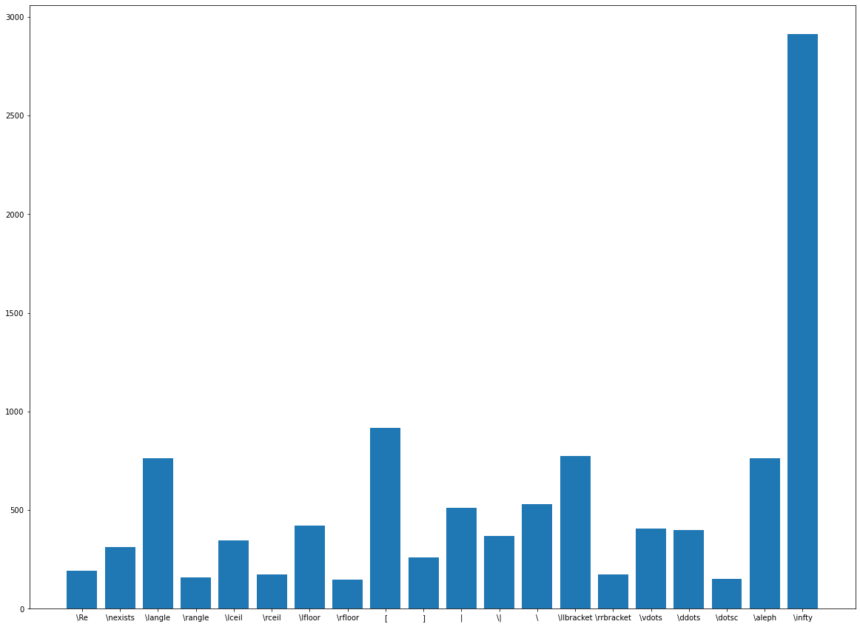

Slide 17
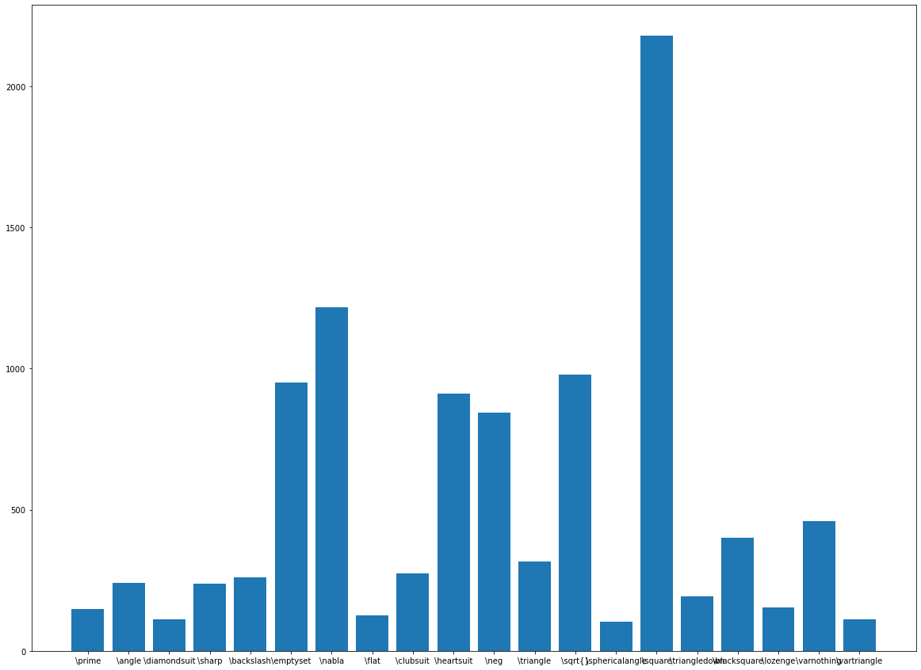

Slide 18
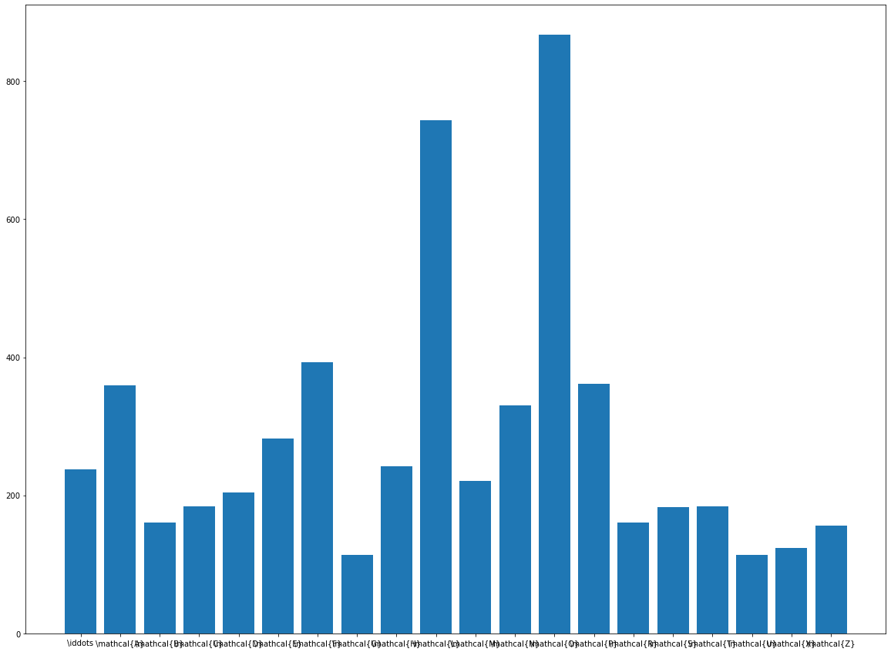

Slide 19
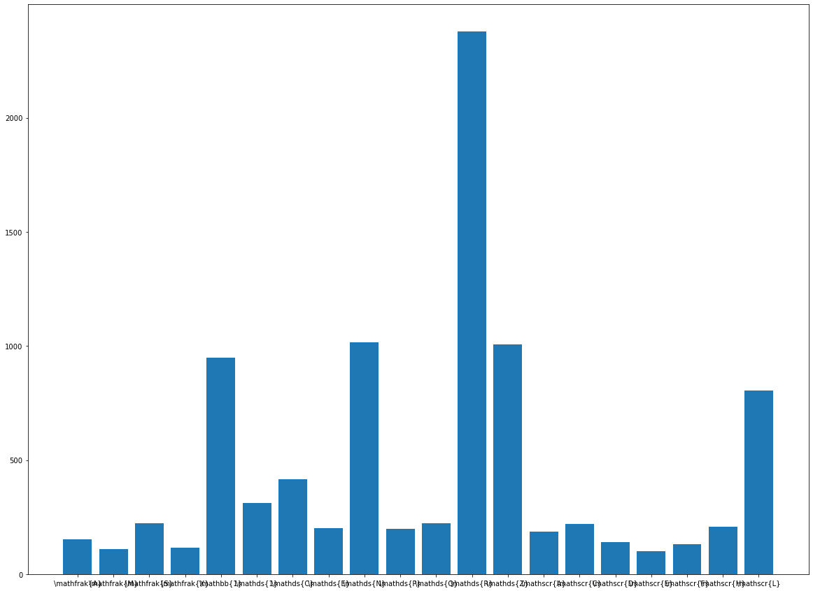

Slide 20

Architecture of the CNN Model
Dropout = 0.2
Second Conv2D
48 Filters
(5,5) kernel size
ReLU
Final Output
(370,1) Array with Probabilities for each class
Third Conv2D
64 Filters
(5,5) Kernel Size
ReLU
First Conv2D
32 Filters
(5,5) Kernel size
ReLU
Max Pooling
2 strides
Max Pooling
2 strides
Input Image (32, 32, 1)
Max Pooling
2 strides
For eg:
Dropout = 0.2
Flattening and 3 dense layers (softmax in last layer)
Dropout = 0.2

Slide 21
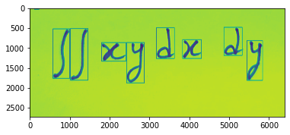

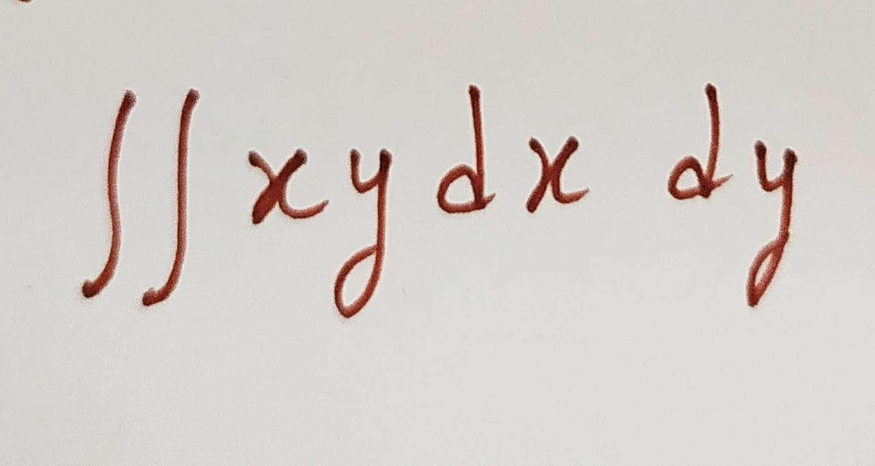
Rough Idea of the Architecture
Final
Result!
Which in this case isn’t accurate :(
Contours Detection
3 layers CNN Model stored weights (.h5 file)
Predictions for each image are done
Input layer = Any Image of any Size
This gives us four values for each character in the image
For each array of these 4 values, an image is taken. Now, this image is resized to (32 , 32)
An array of
x , y, h, w
A (1282, 682) Image

Slide 22
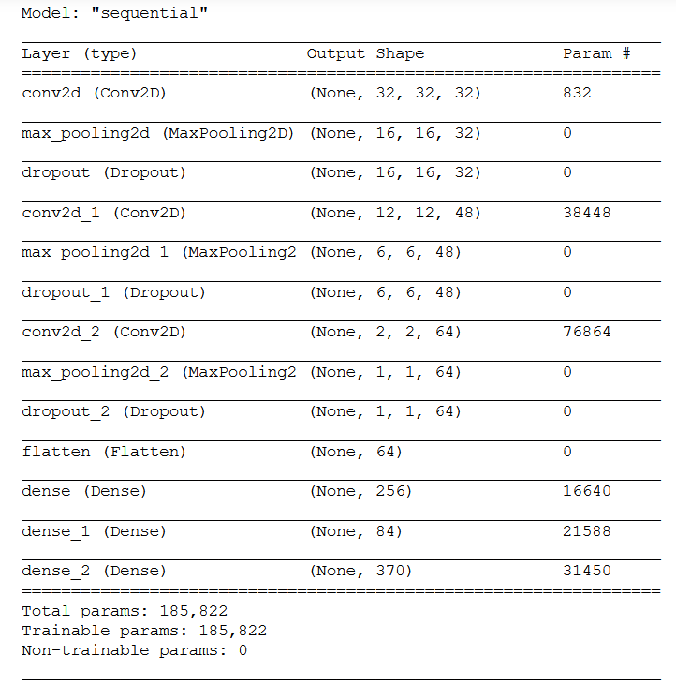
Architecture of the Model
Accuracy of the model - 1. Training set = 76.5 % 2. Validation set = 80.9 % 3. Test Set = 81 %
Some Classes had high accuracy of near to 95 % (these were mainly mathematical symbols).
While, for some classes accuracy was as close to zero!
Like, for almost all of the cases, letter ‘a’ was recognised as ‘\alpha’, letter ‘B’ was recognised as ‘\beta’, ‘\int’ sign was recognised as ‘S’.
While some classes were explanatory, in many of the classes model was just not good enough to differentiate.
For eg : ‘x’ being recognised as ‘%’.
(Screenshot from my Jupyter Notebook)

Slide 23
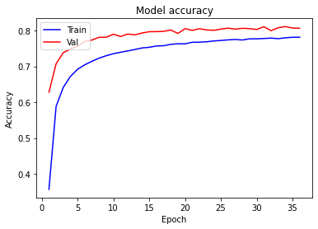

Slide 24
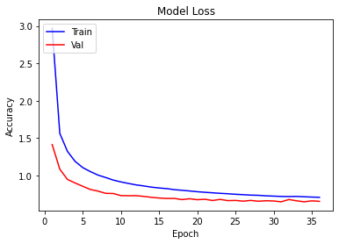

Slide 25
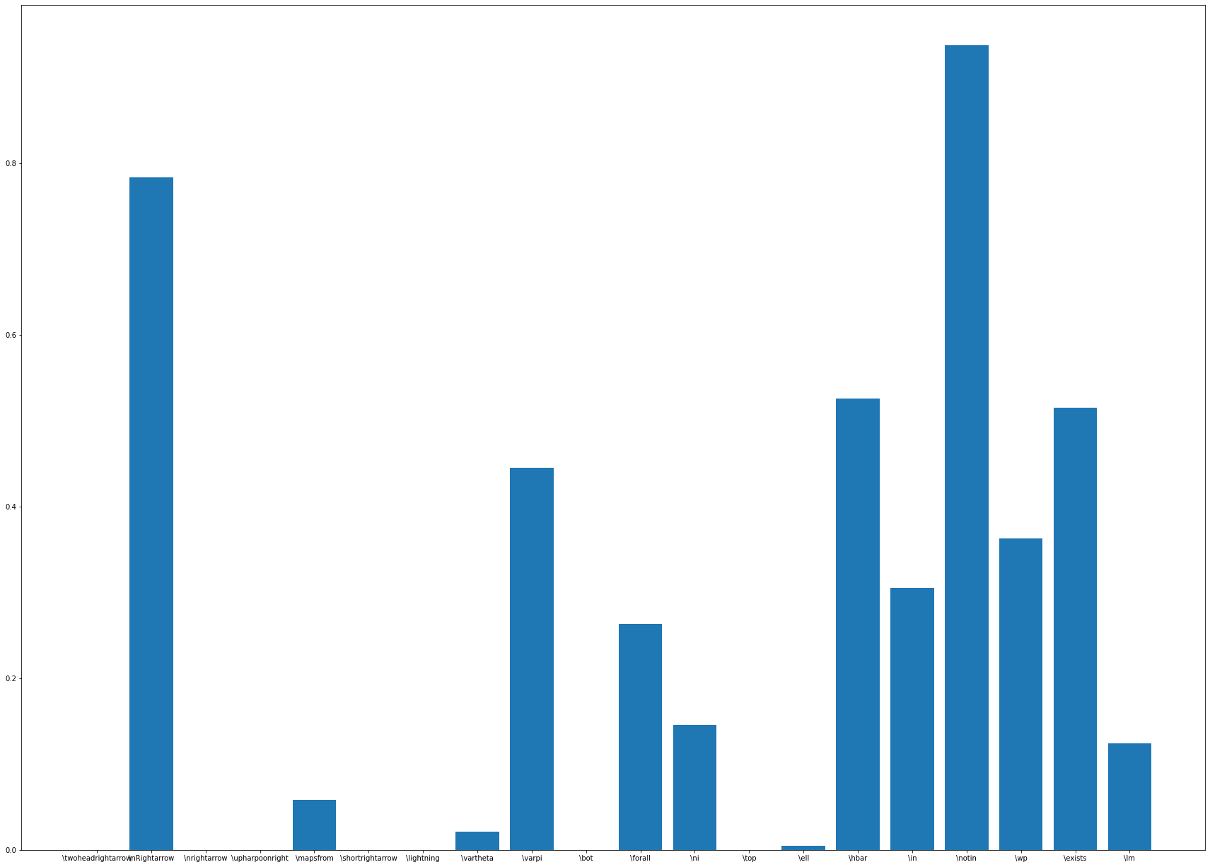
Class-wise Accuracies

Slide 26
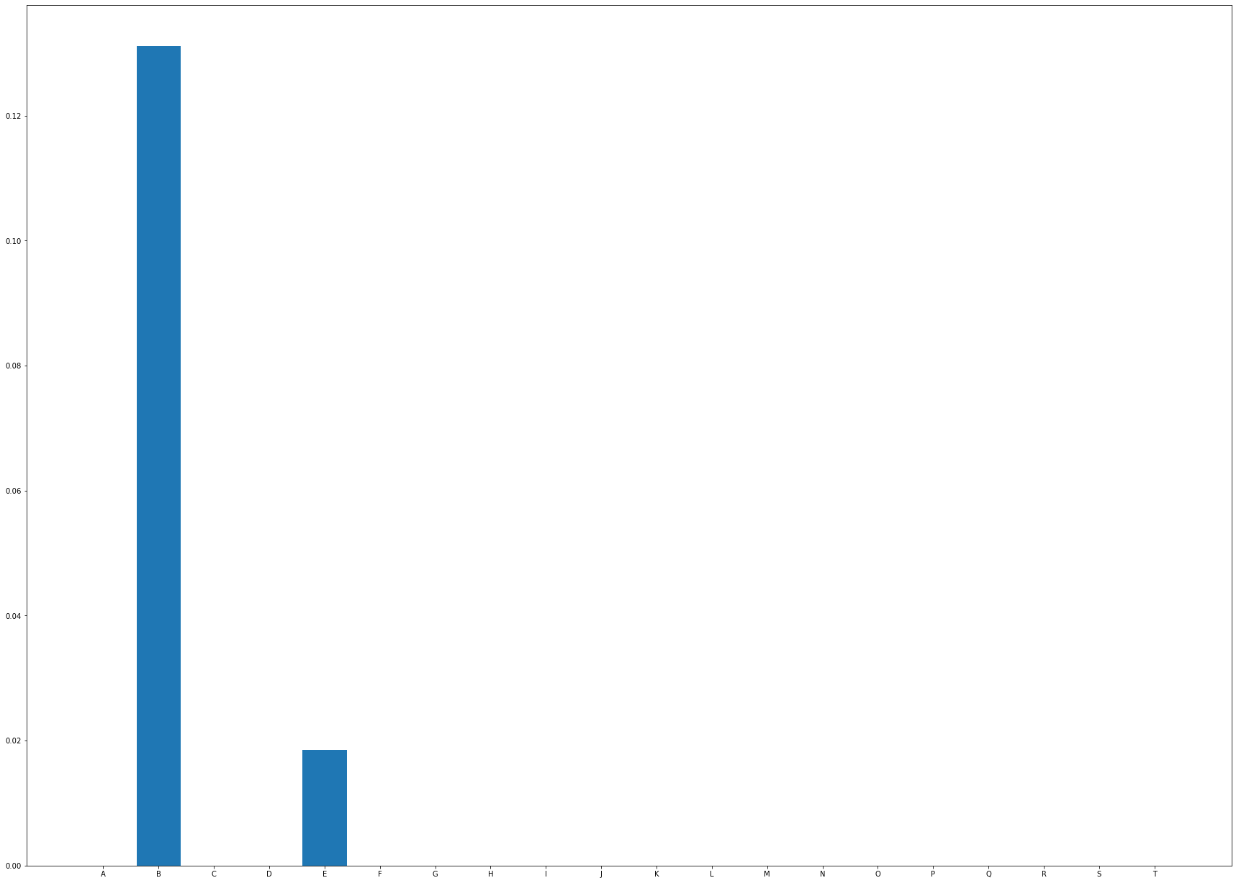

Slide 27
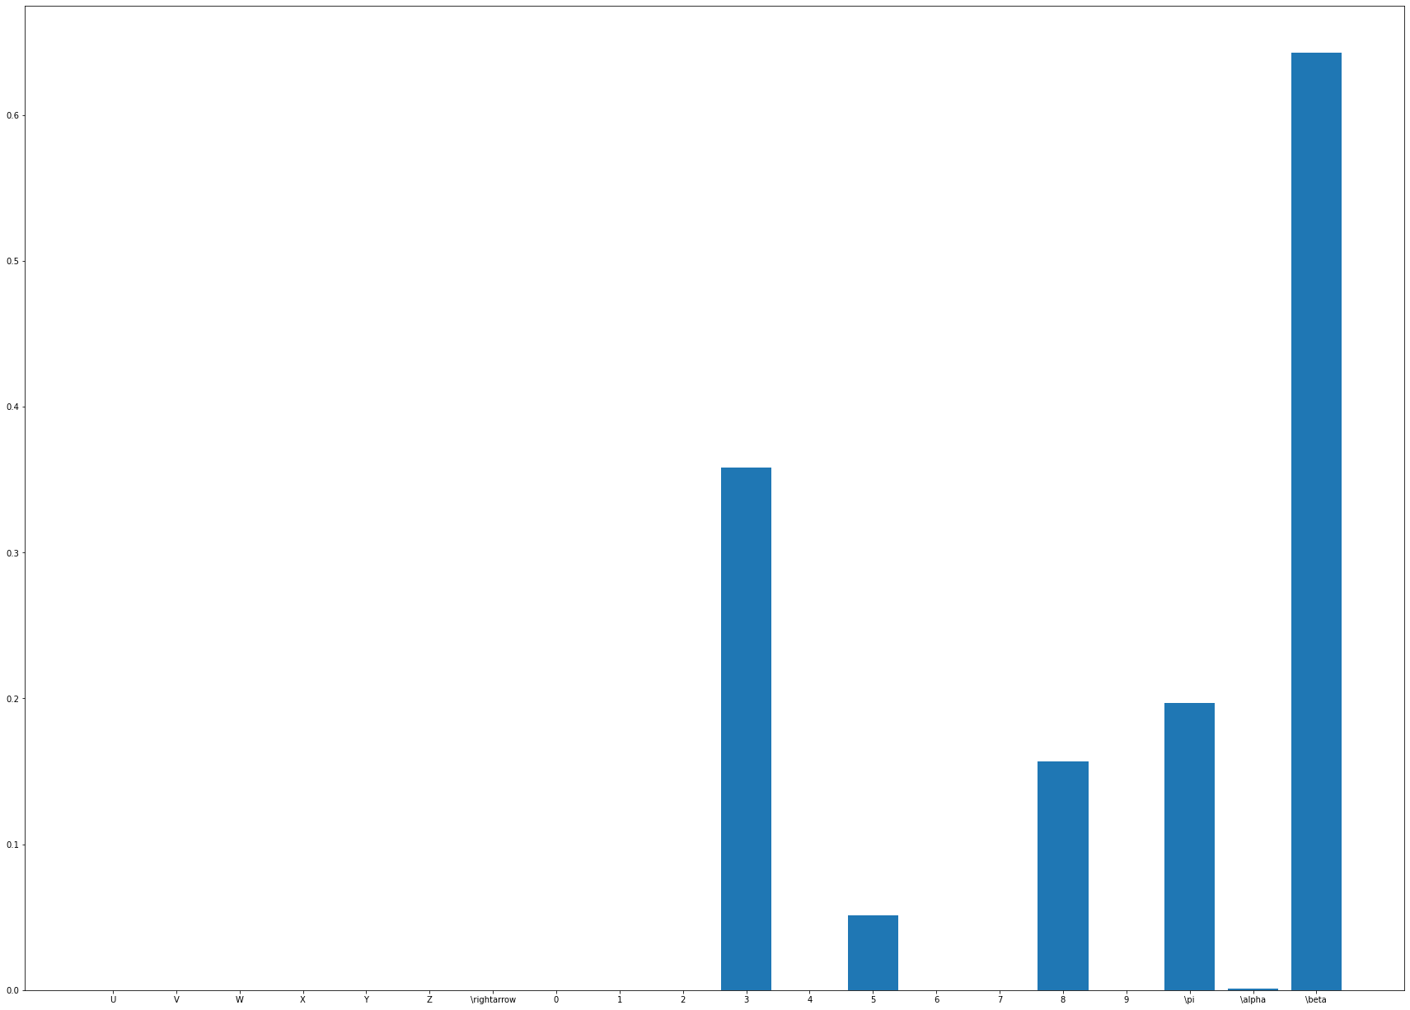

Slide 28
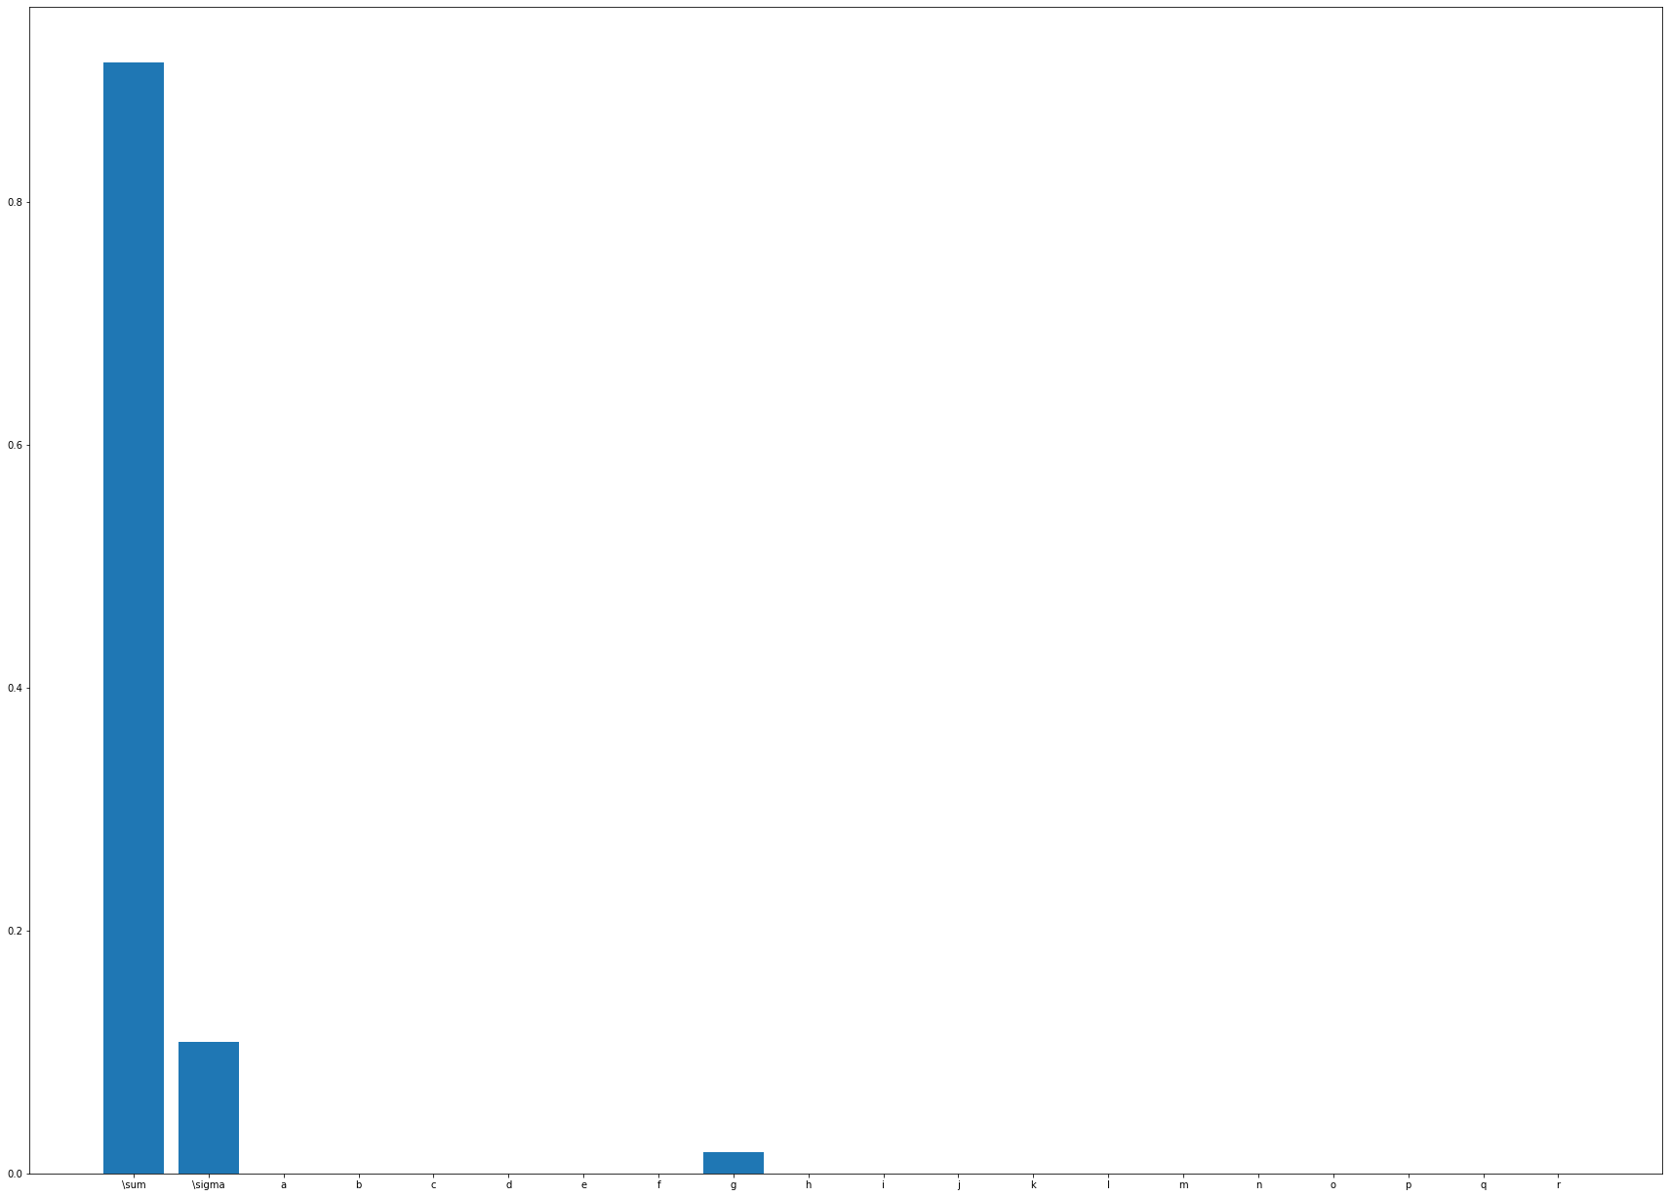

Slide 29
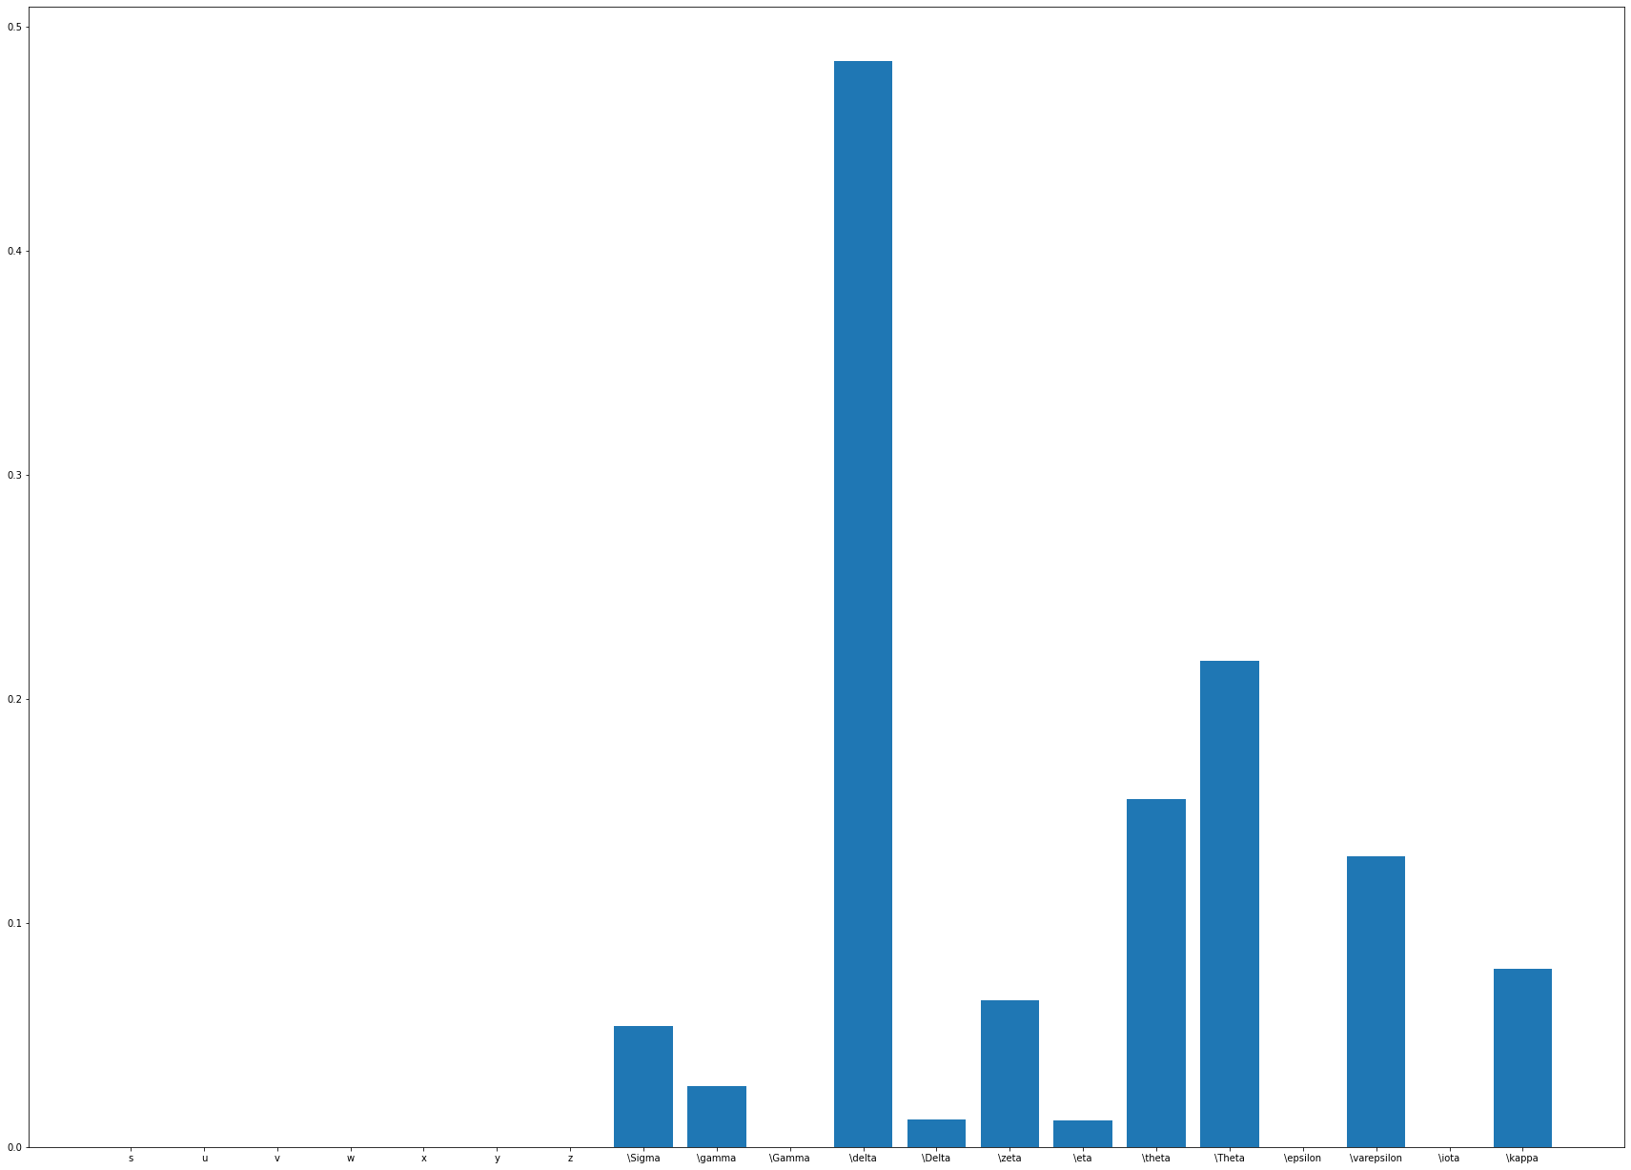

Slide 30
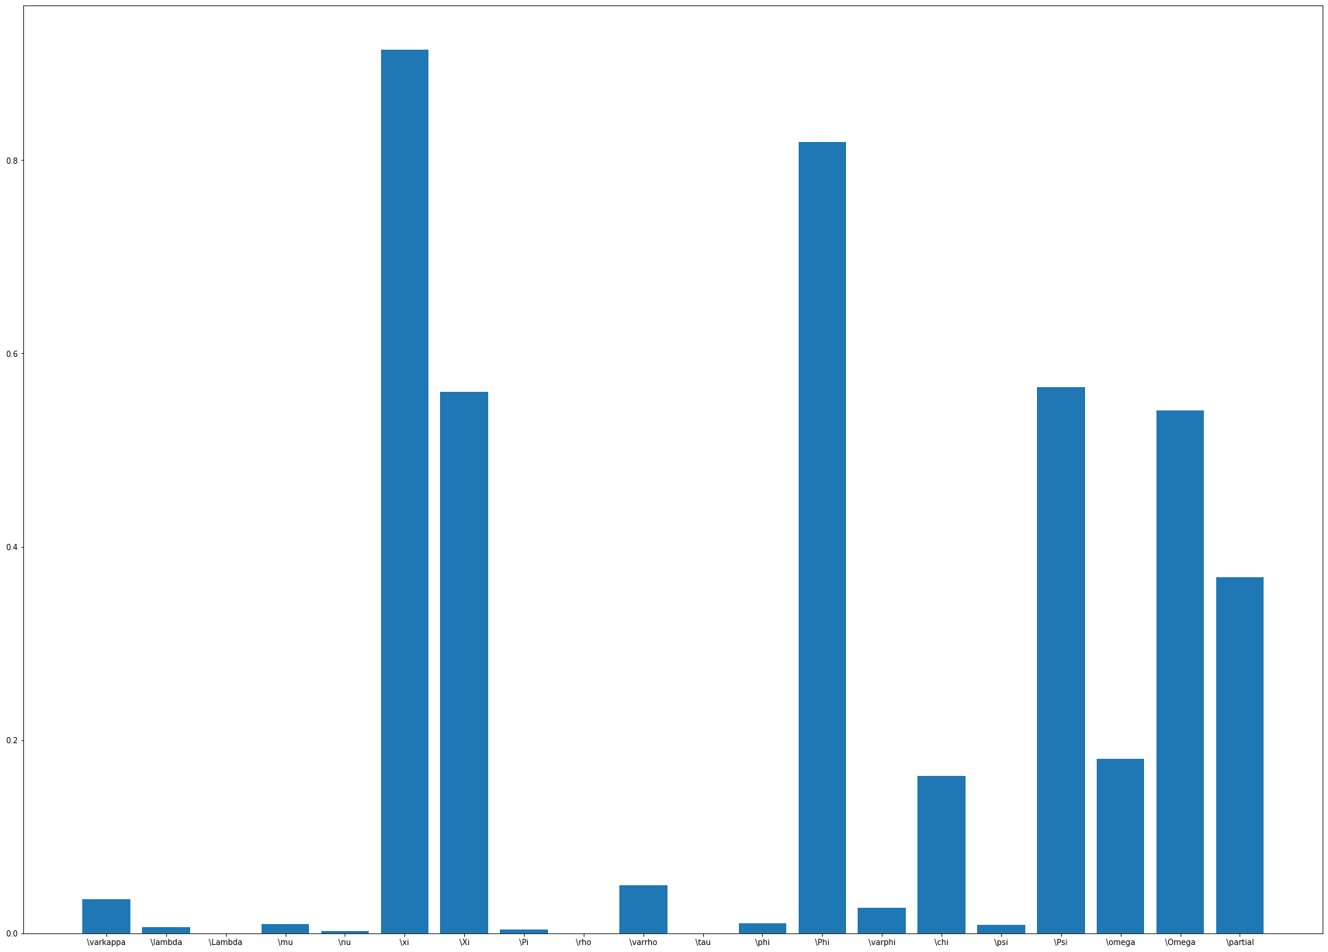

Slide 31
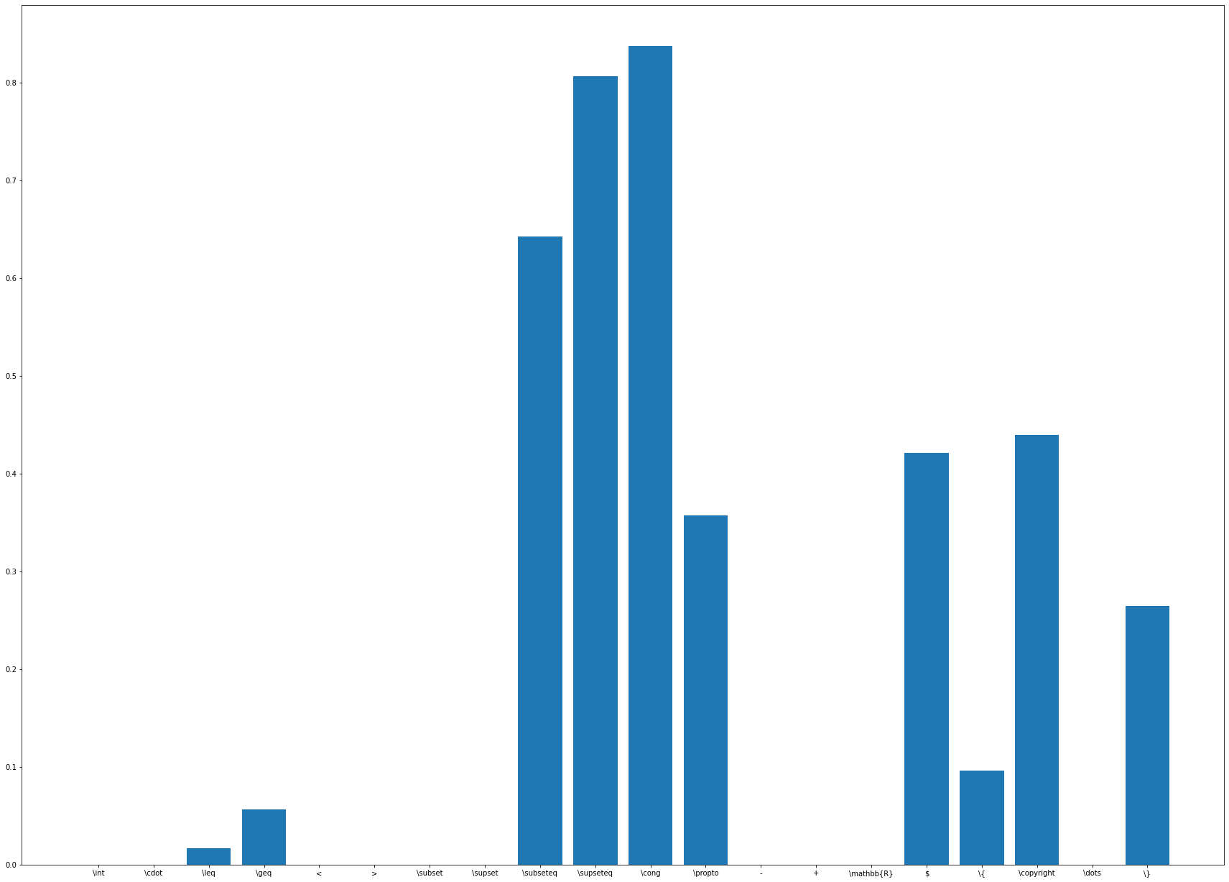

Slide 32
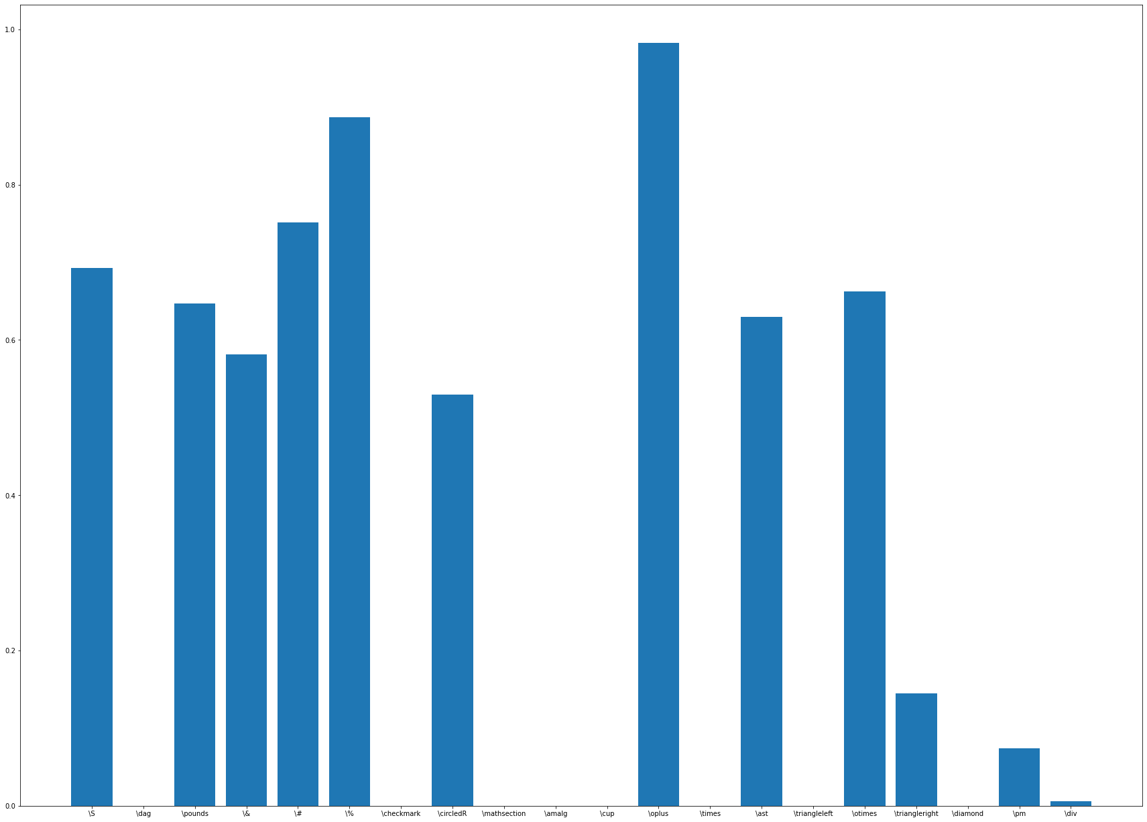

Slide 33
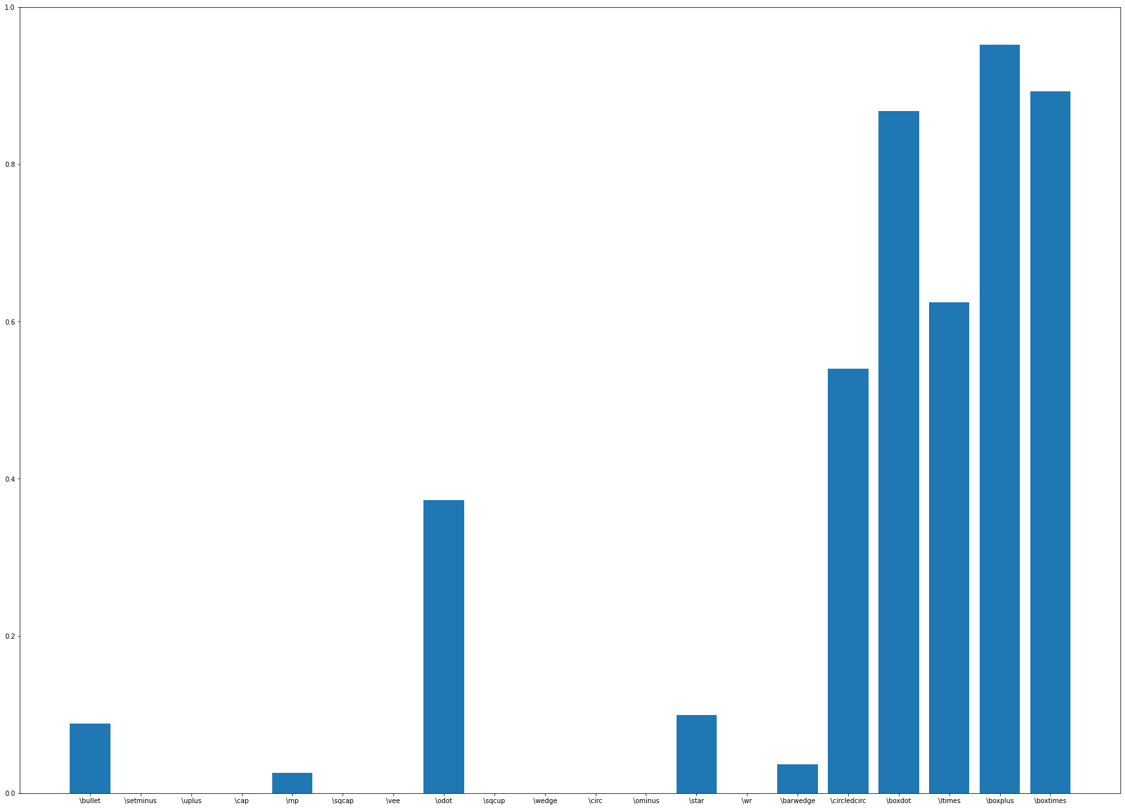

Slide 34
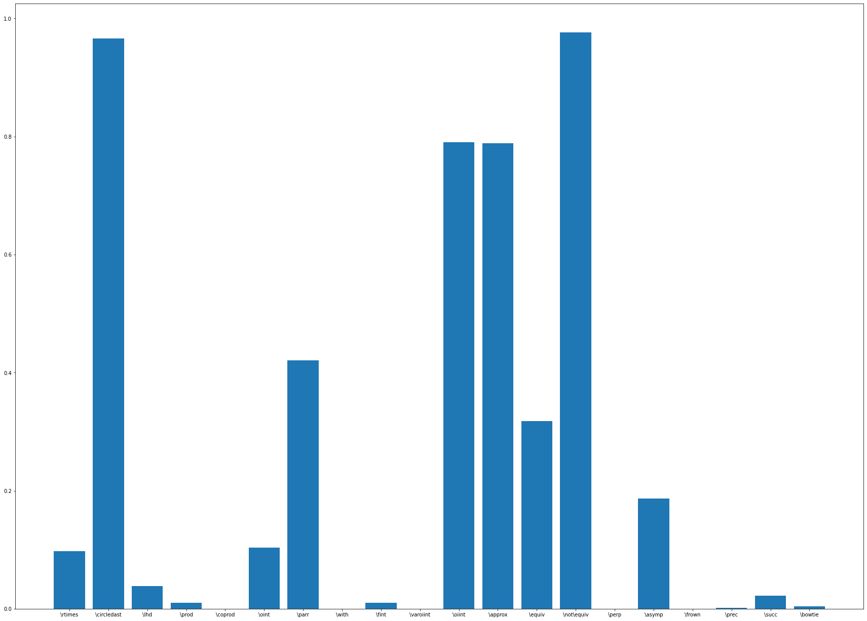

Slide 35
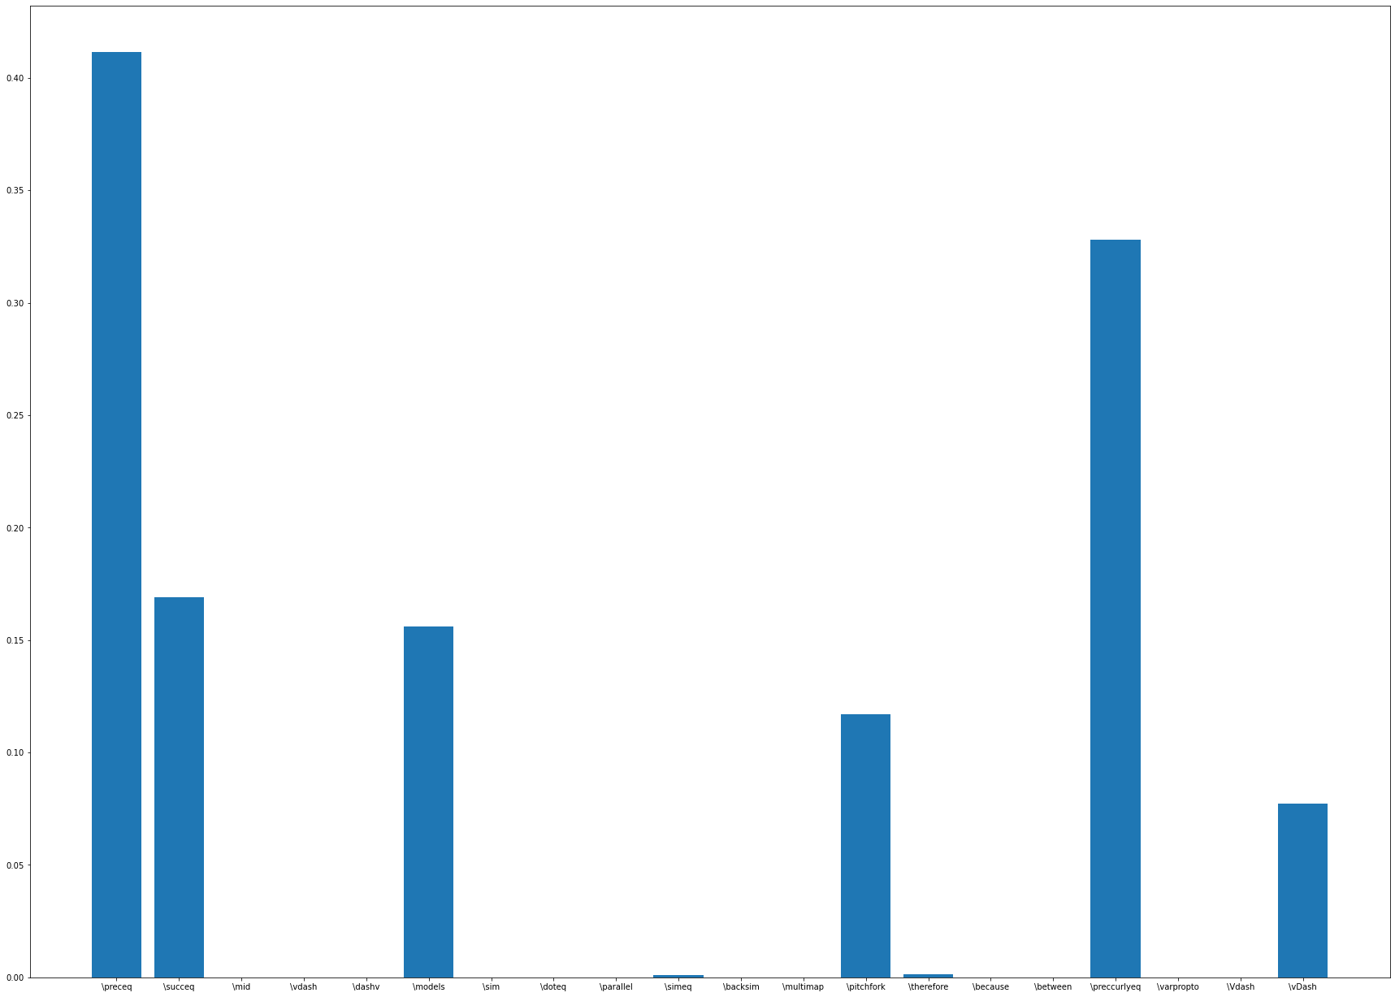

Slide 36
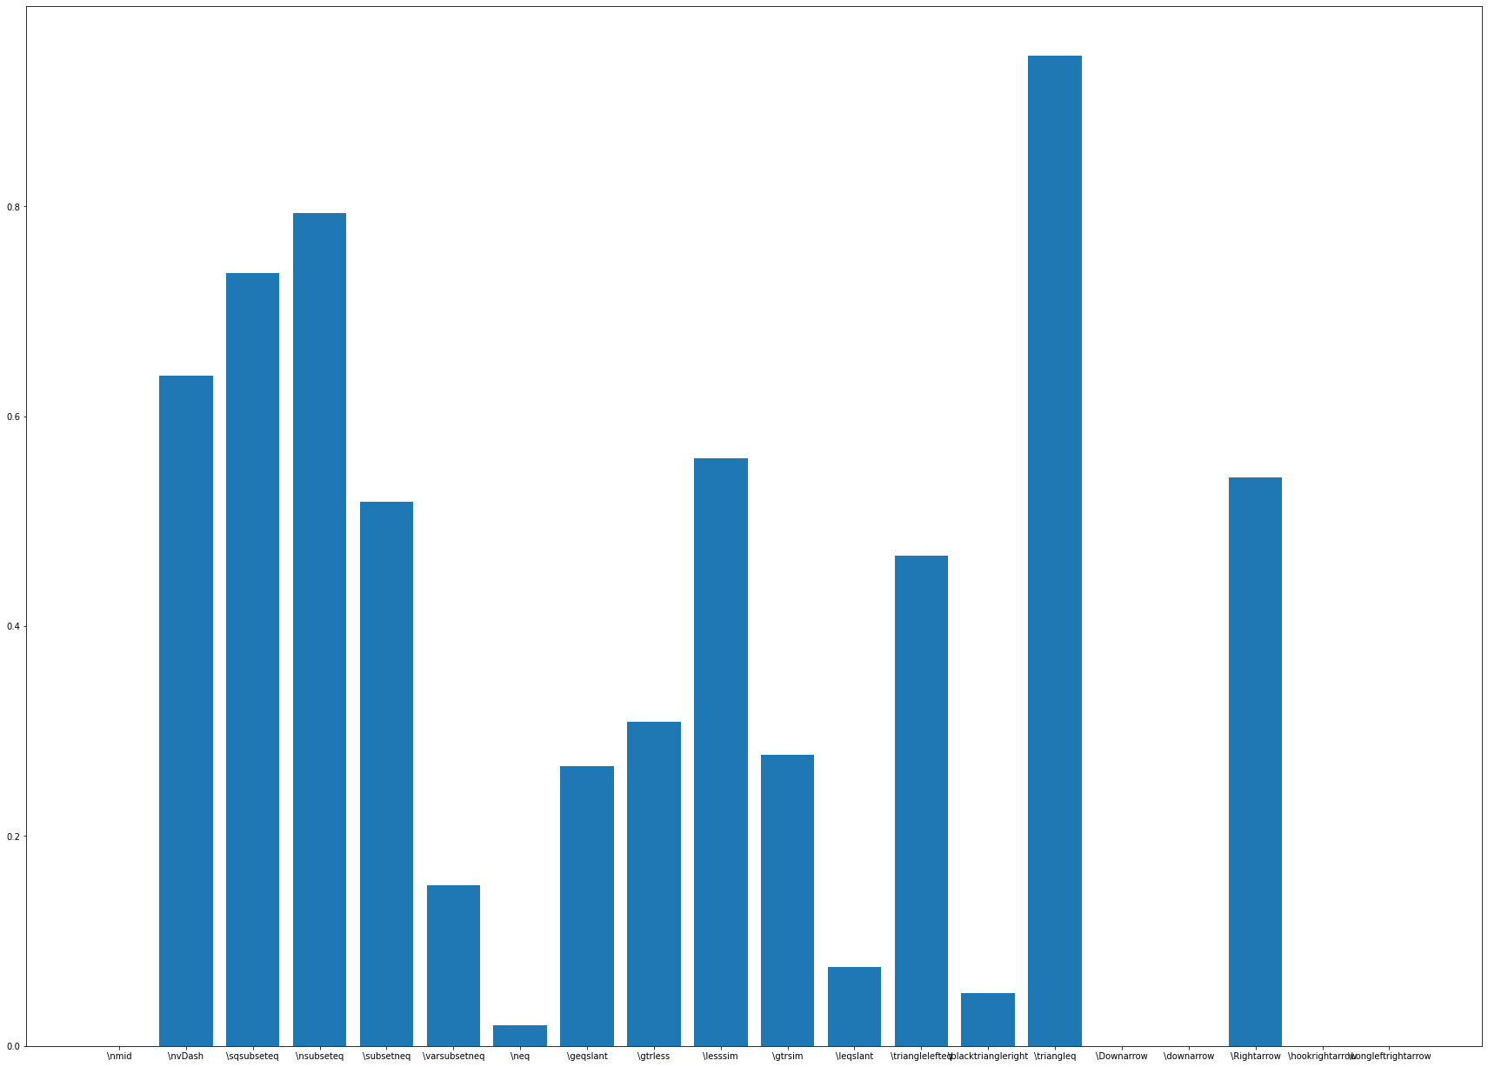

Slide 37
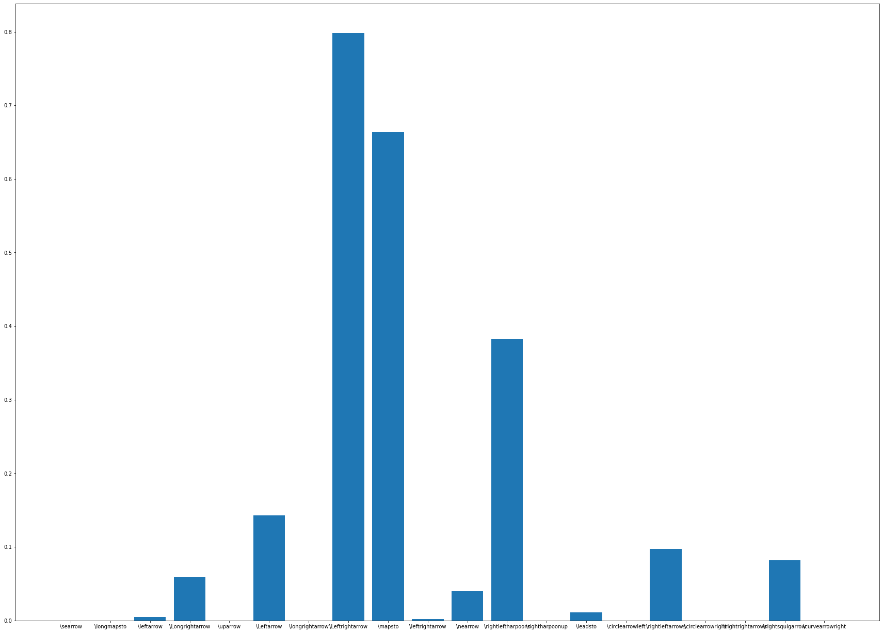

Slide 39
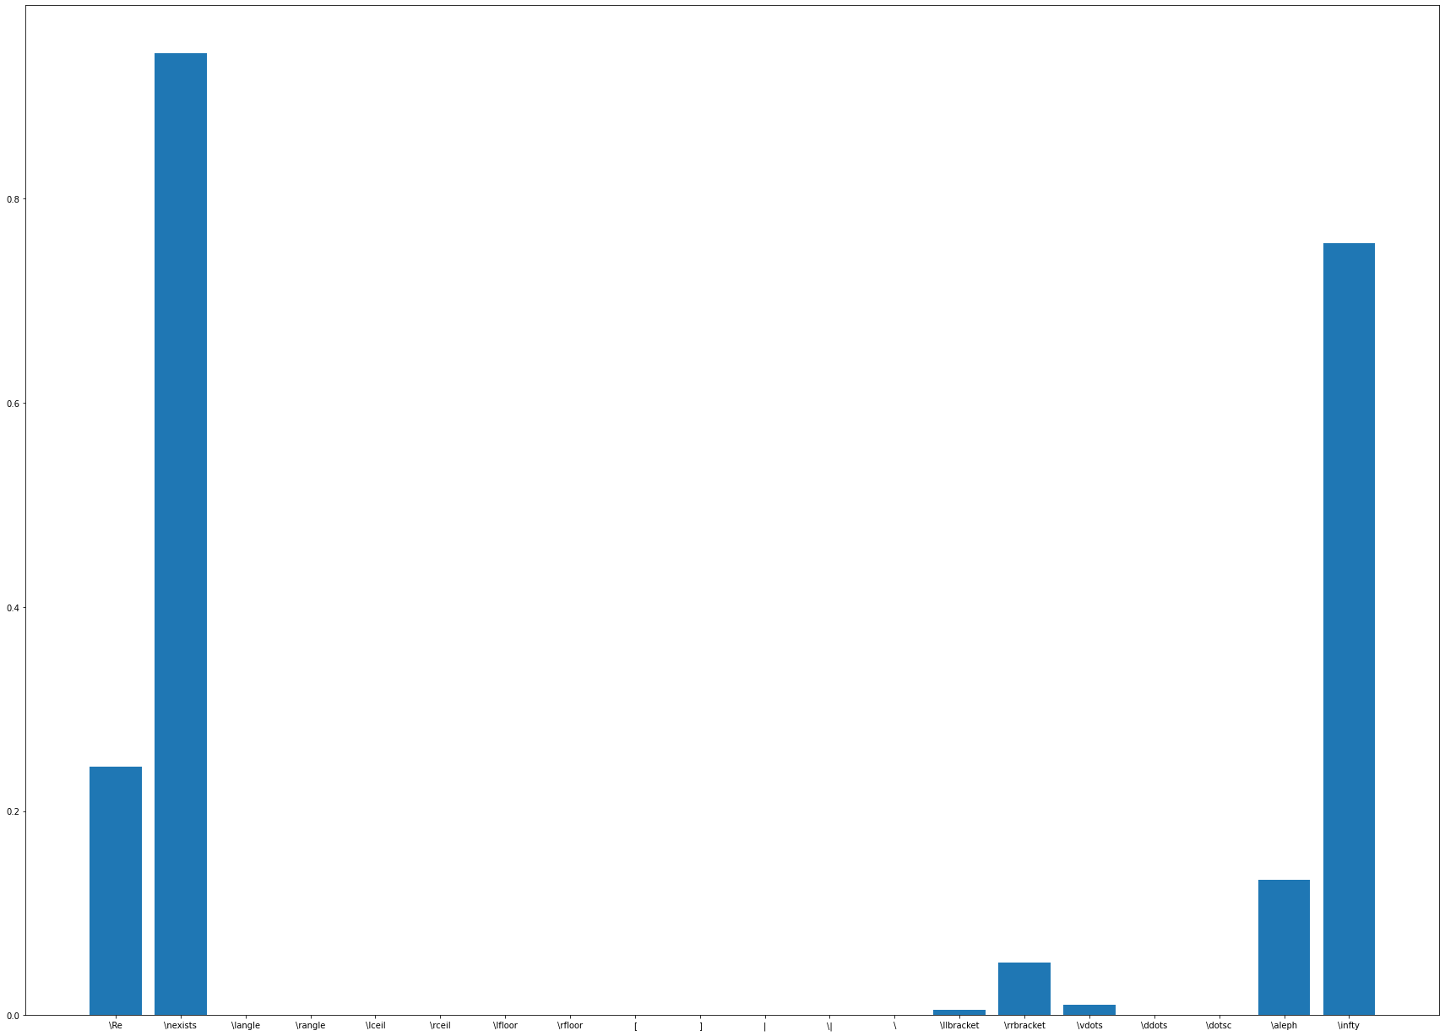

Slide 40
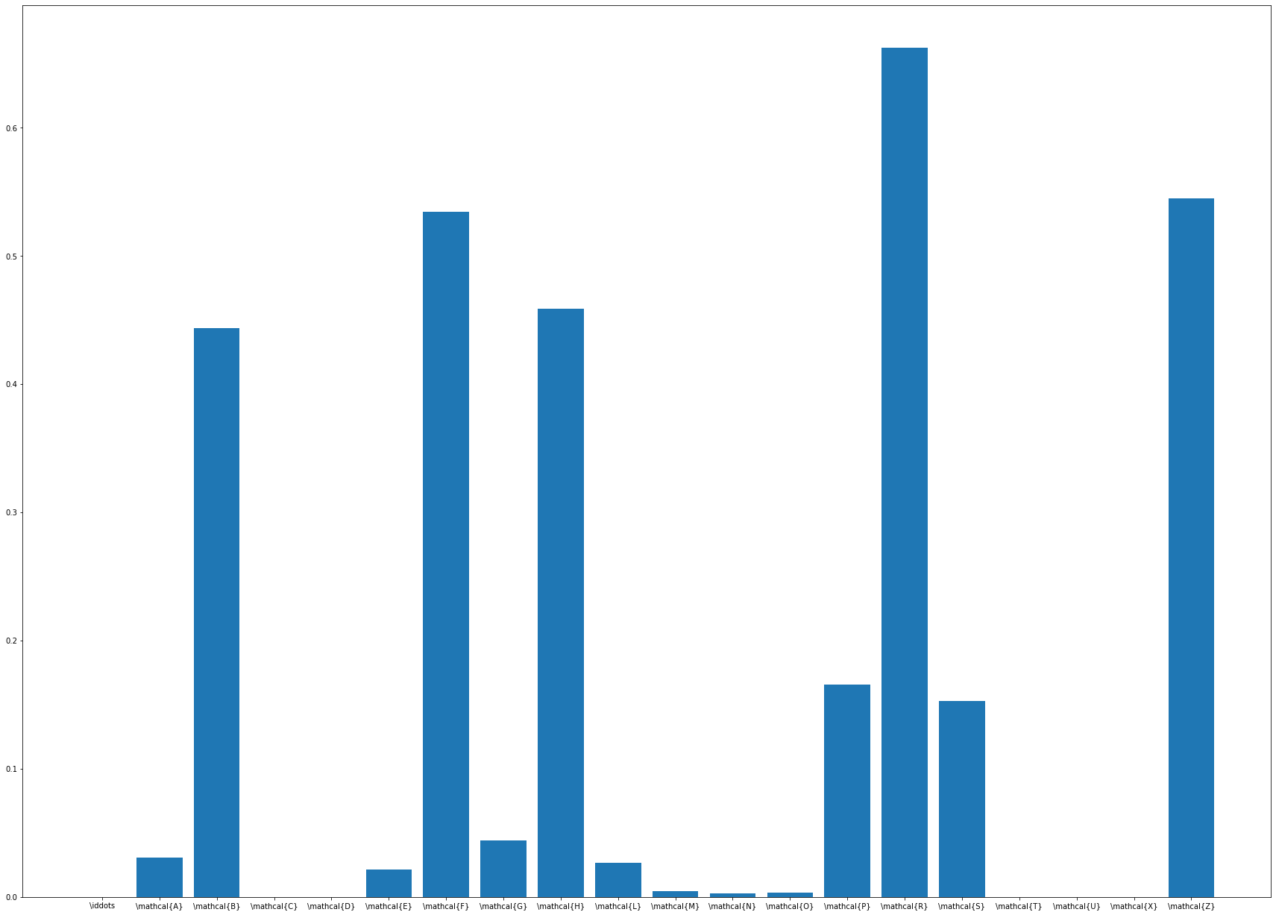

Slide 41
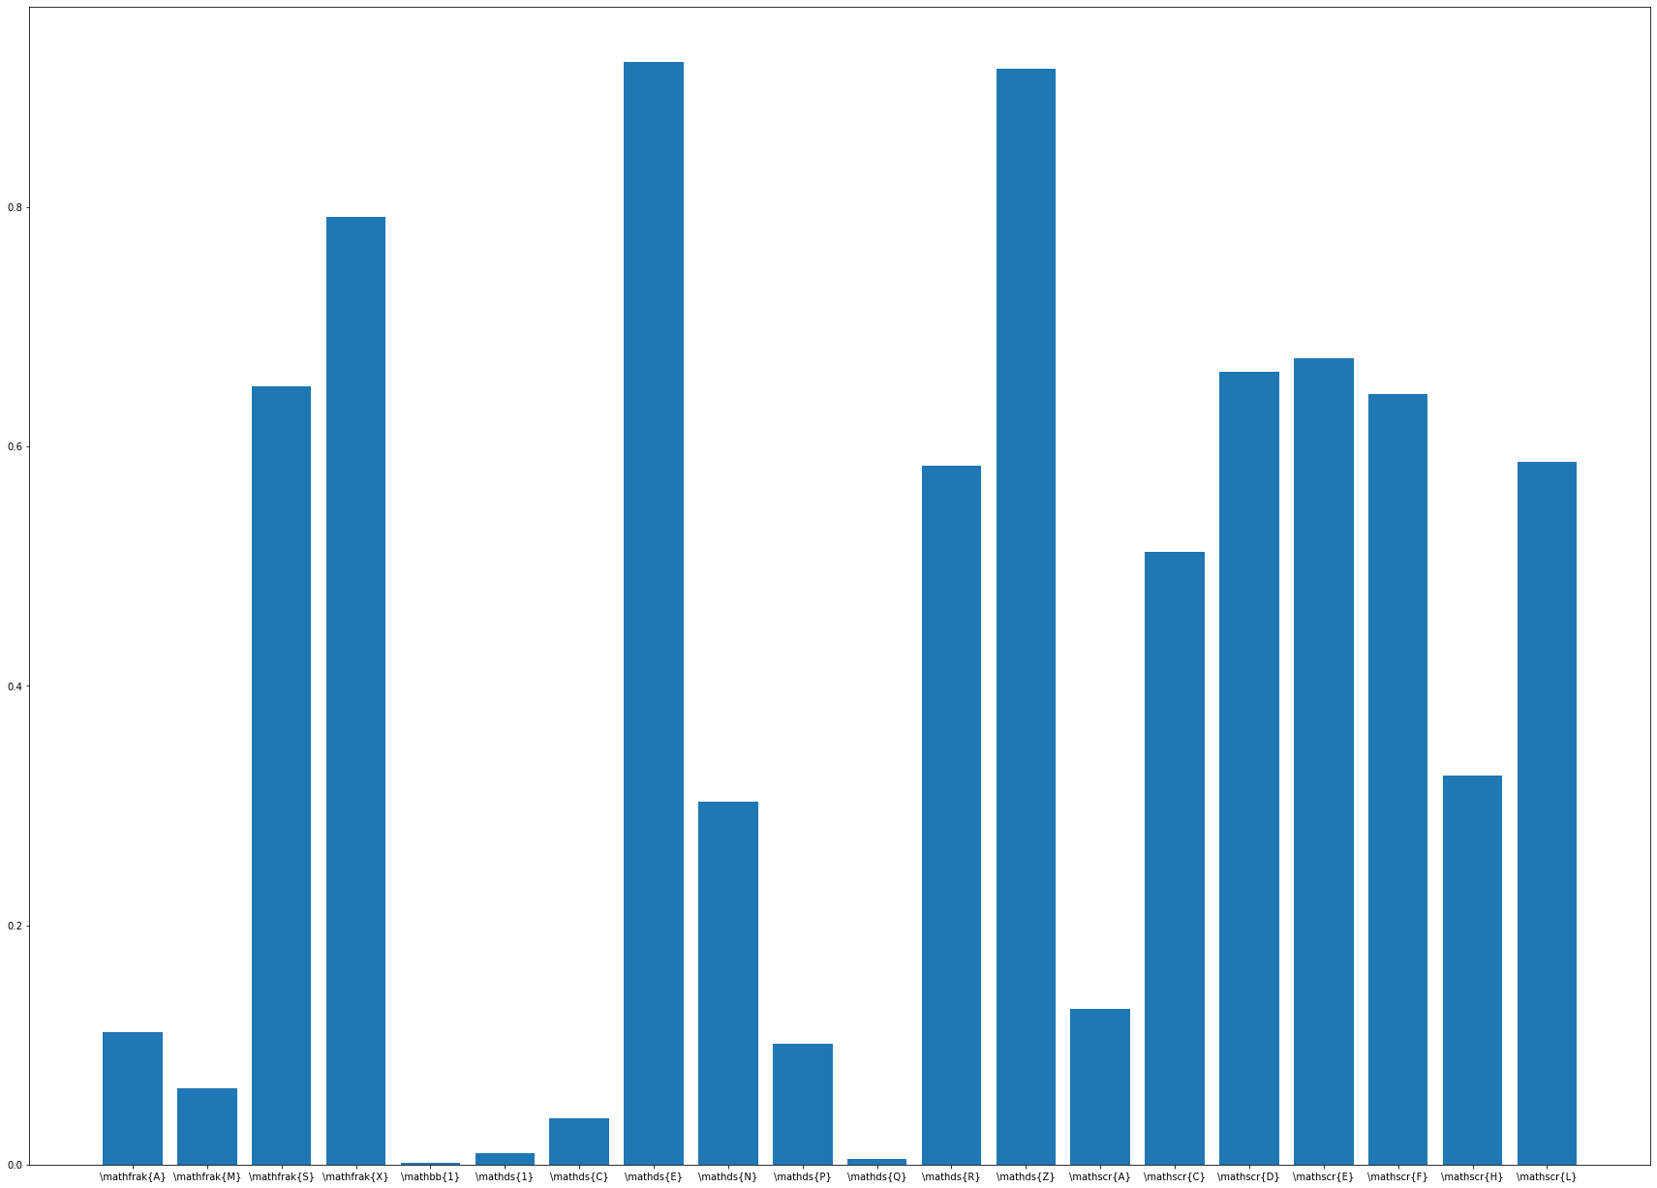

Slide 42
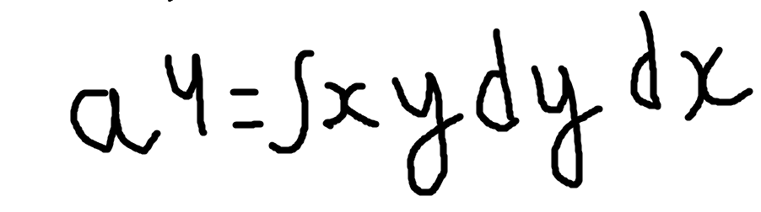
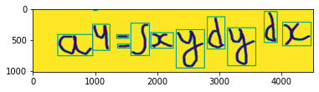

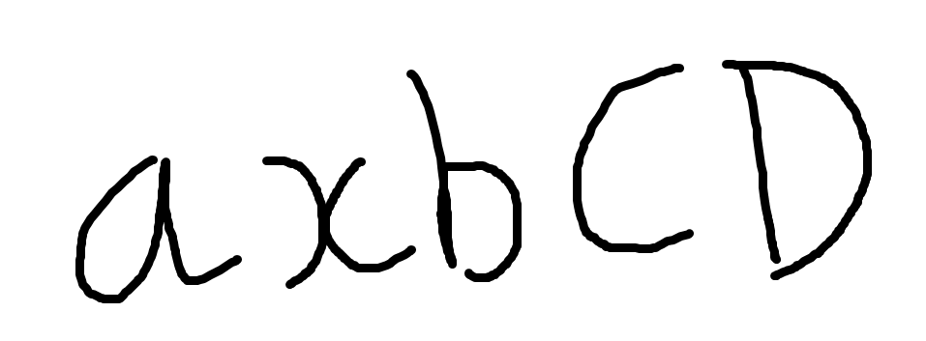
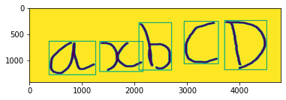
Some results of Segmentation combined with the model
Result
After segmentation
After segmentation
Result
After segmentation
Result

Slide 43




Possible Reasons for Low Accuracy
A 3 layered CNN network isn’t deep enough for classification of 370 classes.
Input images need to be of higher resolution for more feature extraction so that it can classify 370 classes.
Many of the models which have upto 6 Conv2D layers on CIFAR 100 have low accuracy as well (near 80%)
More Validation split in the dataset, in this case it was 10% of the training set.
!=
!=

Slide 44
What Are The Solutions To Improve This Accuracy?
Try deeper CNN networks for this same dataset.
Although a VGGnet Conv2D (an 18 layered CNN Architecture) isn’t feasible (it’d 96 GB of RAM and high GPU’s), try implementing 6-9 layers of Convolutions
Try changing the Max pooling strides, Dropout values, Validation split in those deeper CNN networks.
Some deep learning technique in which the model focuses more on the center values right from the start, because in most of the character images, character is written in the center.
Some kind of an extra network after we get the probabilities of all the classes, an extra network to classify between the two classes which have highest probabilities.

Slide 45
Challenges Ahead
Improving Accuracy over Mathematical Symbols as good as the models on EMNIST datasets.
Look for feasible solutions which involve maybe smaller datasets which contain only important mathematical Symbols.
Try Increasing CNN layers in the model, as far as the feasibility of the system goes.
Look for datasets which have slightly higher resolution images (even 64*64) for better feature extraction.
A long term Goal - Understanding the context of the equation and making the right decision. For eg : If the Model Identifies letter ‘U’ in word “Umbrella” as the \Union sign, it should make a decision that it’s U not \union if the Probability of ‘U’ is also high above some threshold.

Slide 46
Some of the Papers I referred to -
http://cs231n.stanford.edu/reports/2015/pdfs/mohan_lu_cs231n-project-final.pdf
https://www.hindawi.com/journals/mpe/2020/2365076/
https://ai.stanford.edu/~ang/papers/ICPR12-TextRecognitionConvNeuralNets.pdf
https://github.com/jungomi/math-formula-recognition
https://aihubprojects.com/handwriting-recognition-using-cnn-ai-projects/

